Slide 1
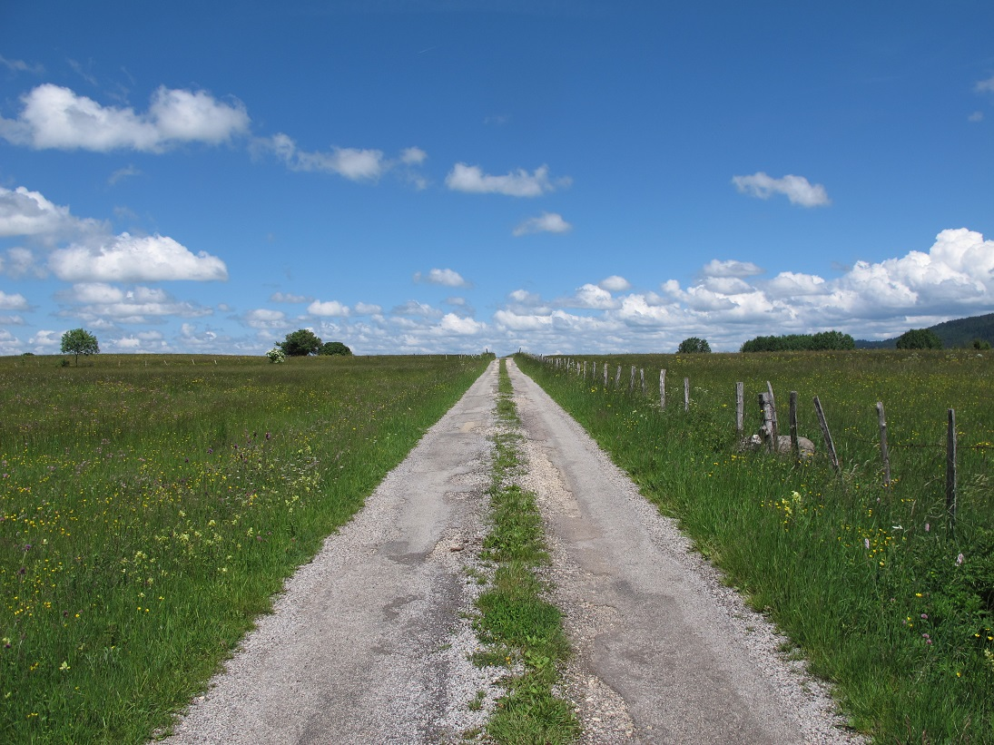
Bayesian integrated population modeling (IPM) using JAGS
Michael Schaub, Marc Kéry
Olivier Gimenez, Maud Quéroué
on-line workshop 23 – 27 November 2020

Slide 2
Bayesian integrated population modeling (IPM) using JAGS
or: Your road to infinite, scientific happiness
Michael Schaub, Marc Kéry
Olivier Gimenez, Maud Quéroué
on-line workshop 23 – 27 November 2020

Slide 3
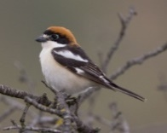
Goals of the workshop
Introduce integrated population modeling (IPM) to biologists and wildlife managers in the only widely accessible way: using the BUGS statistical language
Along the way, introduce a range of useful models for population analysis (as ingredients of IPMs)
Demystify Bayesian analyses; show how they are conducted in practice
Demonstrate the great value of data simulation
Illustrate importance of four key concepts in applied statistics: 1. linear models 2. GLMs 3. random effects 4. hierarchical models
Free the modeler in you !
Notes:
blablabla

Slide 4
Style concepts
Learning by doing
Key style concepts (as in BPA and in AHM):
Gentle introduction
Lots of fully documented example analyses
JAGS (BUGS language) run from program R
Simulated data sets & real-life data
Clear and consistent layout of R/BUGS code
4 books (soon 5)
Bayesian analysis for population ecology
Bayesian population analysis using WinBUGS (BPA)
Applied hierarchical modeling in ecology, vol 1 and 2 (AHM1 and AHM2)
Notes:
blablabla

Slide 5
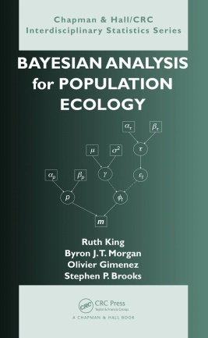
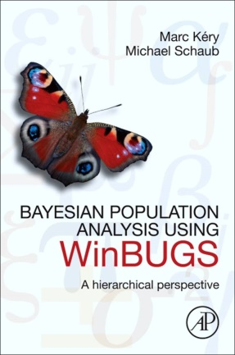
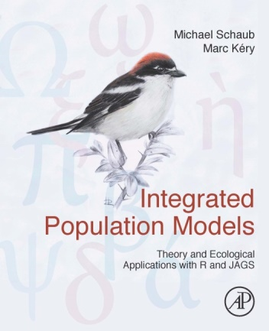
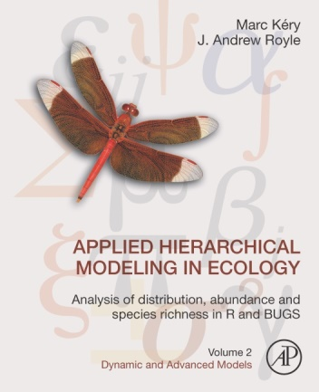
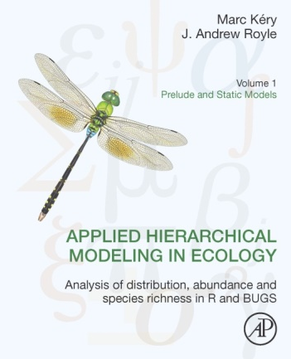
Books
due mid 2021
Notes:
blablabla

Slide 6
Web
Useful web sites:
www.hierarchicalmodels.com
www.vogelwarte.ch/bpa
www.mbr-pwrc.usgs.gov/pubanalysis/keryroylebook
Notes:
6
blablabla

Slide 7
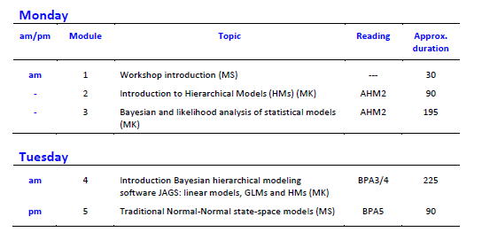
Program
Notes:
7
blablabla

Slide 8
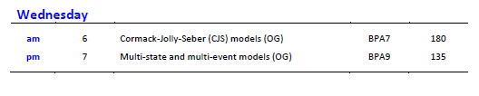
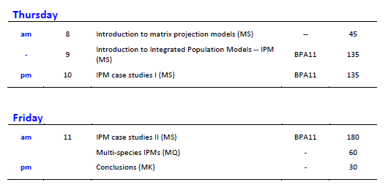
Program
Notes:
8
blablabla

Slide 9
General daily schedule
Lectures and breaks at regular times (CET):
9.00 – 9.45h: lecture
10.00 – 10.45h: lecture
11.00 – 11.45h: lecture
12.00 – 12.45h: lecture
14.00 – 14.45h: lecture
15.00 – 15.45h: lecture
16.00 – 16.45h: lecture
Notes:
9
blablabla

Slide 10
Zoom
Interrupt us (speak up) if you have questions that are of general interest
Ask simple questions via the chat option
For more complex questions: write an e-mail
michael.schaub@vogelwarte.ch; marc.kery@vogelwarte.ch; olivier.gimenez@cefe.cnrs.fr; maud.queroue@gmail.com
The lectures will be recorded and the link to view them will be made available (via dropbox)
Generally switch off your microphone and video
Notes:
10
blablabla

